Slide 1
Hardware Characterization

Slide 2


Single Qubit Routines
Hardware Characterization
Two Qubits Interactions

Slide 3

Single Qubit Routines

Slide 4
Single Qubit Routines
Gate Set Characterization
Low Level Characterization

Slide 5
Single Qubit Routines
Gate Set Characterization
Standard Randomized Benchmarking

Slide 6
Single Qubit Routines
Resonator Characterization
AllXY & Drag Pulse Tuning
Readout Optimization
Qutrit classification
Couplers
Ramsey
Zeno
Dispersive Shift
Fast Reset Test
Low Level Characterization
Qubit Characterization
Single-shot classification
Readout Characterization
TWPA Optimization
Time of Flight Readout
Avoided crossing
Rabi
T1 & T2
Flipping

Slide 7

Single Qubit Routines
Resonator Characterization
Couplers
Resonator Spectroscopy
Resonator Punchout
Resonator Flux Dependence
Resonator Crosstalk
Qubit Characterization
Rabi

Slide 8
Resonator Characterization
Couplers
Single Qubit ...
Qubit flux tracking
Qubit Crosstalk
Qubit Flux Dependence
Qubit Spectroscopy
Qubit Characterization
Rabi

Slide 9
Single Qubit Routines
Couplers
Ramsey
Qubit spectroscopy
Resonator spectroscopy
Rabi
T1 & T2

Slide 10
Couplers
Ramsey
Single Qubit ...
EF Transition
Length
Amplitude
Rabi
T1 & T2

Slide 11
Single Qubit Routines
Ramsey
Zeno
Standard
Detuned
T1 & T2
Single-shot classification

Slide 12
Dispersive Shift
Readout Optimization
Single Qubit ...
Mitigation matrix
QND-ness
Fidelity
Readout Characterization
TWPA Optimization

Slide 13
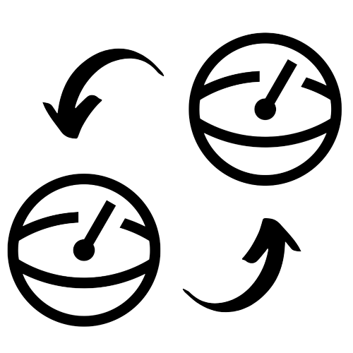
Two Qubits Interactions

Slide 14
Chevron
Two Qubits Interactions
Tune Landscape

Slide 15
Thank you

